Slide 1
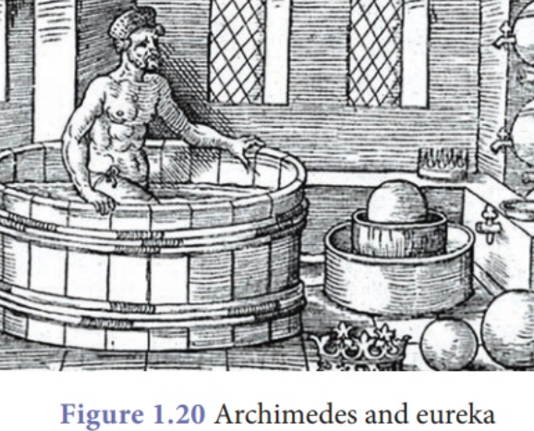
The ‘AHA’ Moment
On behalf of the LxBx Consortium of the NCI, I see medical advances through the small lens of ‘AHA’. :
Lymphoma of Brain, Viral Vectors- gene therapy, EV mRNA (Skog)
“The “AHA" moment involves suspension of disbelief to “wipe out the ego.” (Bezerglanov)
Our goal:
To introduce to you academic LxBx Session Chairs and Investigators
Encourage questions (CHAT), and collaborations.
My thanks: Lynn Sorbara, Sudhir Srivastava, David Wong, Richard Cote,, Nick Papadopoulos, Johan Skog, Bob Carter, Juan Miguel Villanueva

