Slide 1
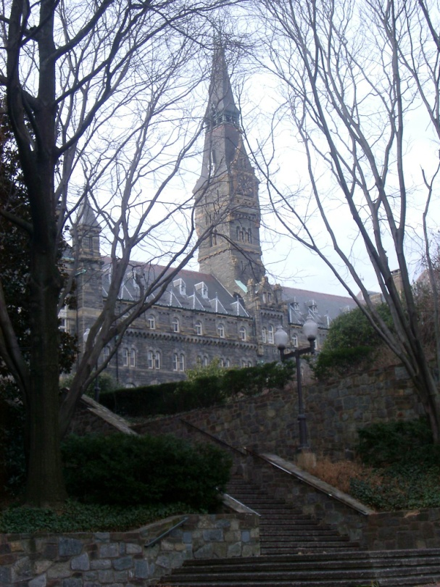
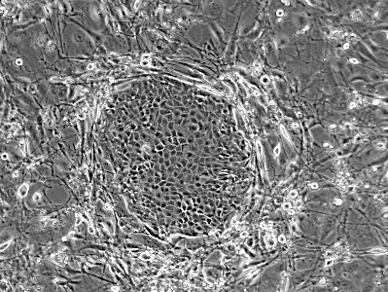

Viable Circulating Tumor Cells: A Critical Analyte
for Cancer Research and Management
Center for
Cell Reprogramming
Georgetown
Dr. Richard Schlegel (Part A)
Dr. Seema Agarwal (Part B)
Georgetown University Medical Center
Department of Pathology
Center for Cell Reprogramming

Slide 2
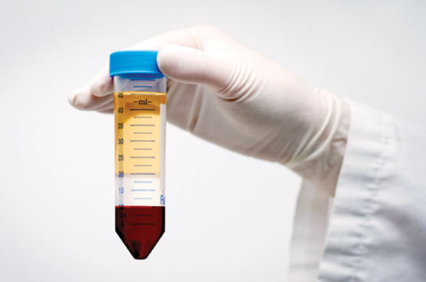
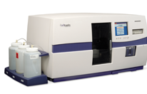
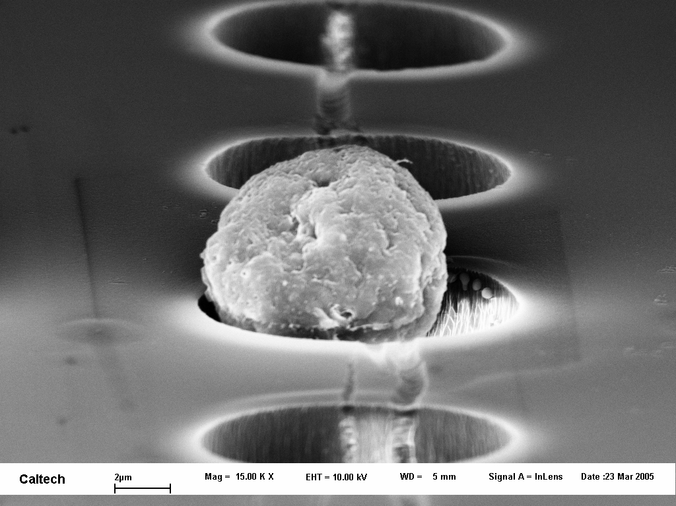
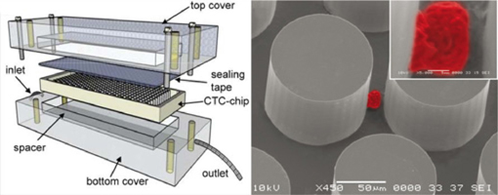
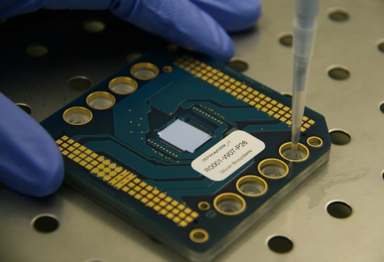
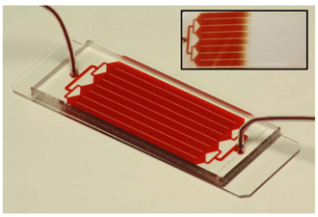

Current Methods for CTC Detection
Label Free
Affinity-Based
Gradient Based:
Ficoll-Paque
RareCyte
Immunomagnetic:
CellSearch
AdnaTest
MACS
Size Based:
Circulogix
ISET
ScreenCell
Parsortix (ANGLE)
Microfluidic:
CTC-iChip
GEDI Chip
OncoCEE
Dielectrophoresis:
ApoStream
DEPArray
Surface Based:
Herringbone Chip
Graphene Oxide

Slide 3
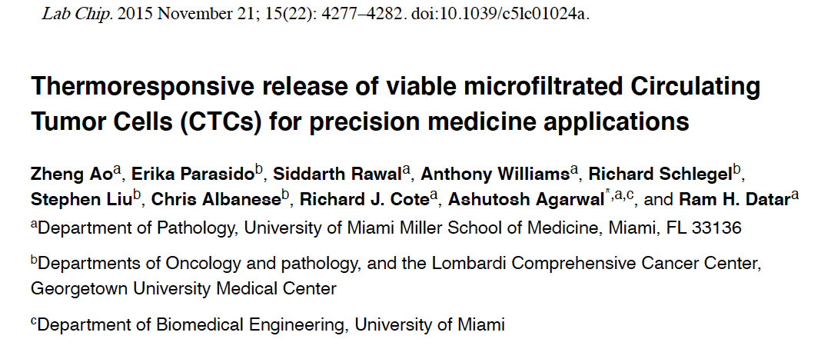
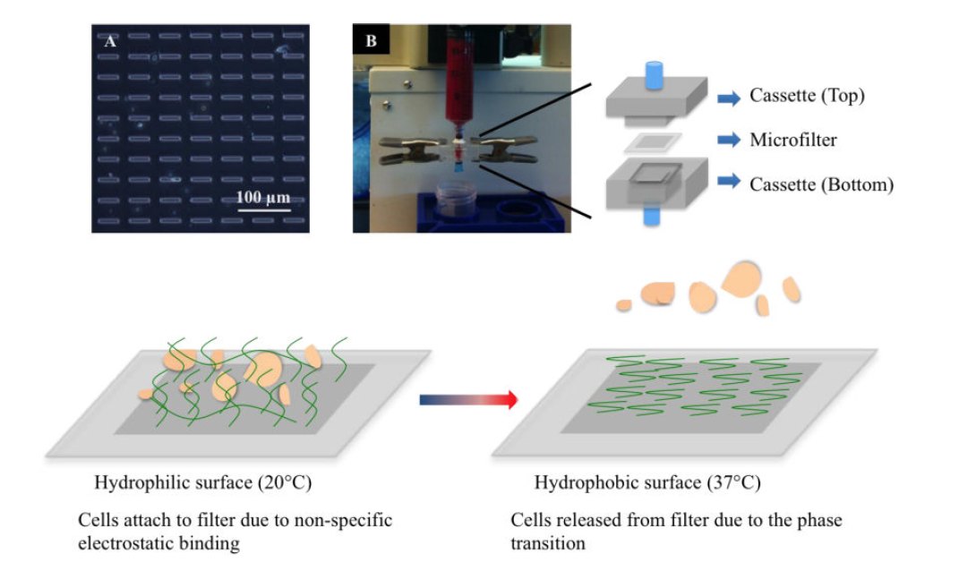
Thermoresponsive release of viable microfiltered Circulating Tumor Cells (CTCs) for precision medicine applications

Slide 4

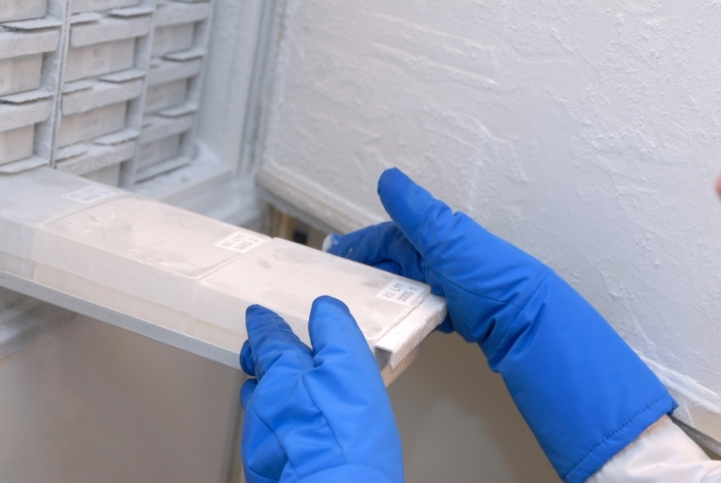
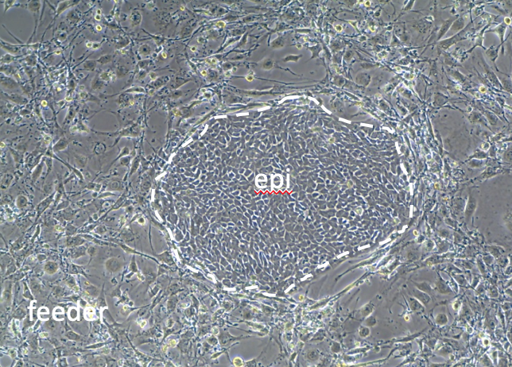
Patient-derived cell cultures (PDCs) via conditional reprogramming
Surgical specimens
Core biopsies
Fine needle aspirates
Blood/Urine
PDCs
Biobank
Inexhaustible supply
Live cell biology
Chemosensitivity
2D (CR)
3D (ALI, organoid)
xenograft
Tumor heterogeneity
single cell analysis
Drug metabolism
Vaccine development
Molecular Diagnostics
PCR
DNA / RNA sequencing
CGH / Karyotyping / SKY
ISH
IF/IHC
Proteomics
Metabolomics
Glycomics

Slide 5
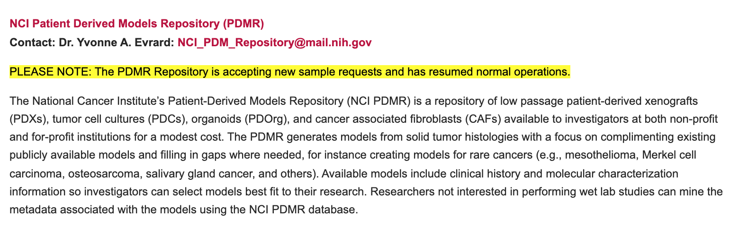
PDCs are a component of the NCI tumor
model repository
https://dtp.cancer.gov/organization/btb/tumor_repositories.htm

Slide 6
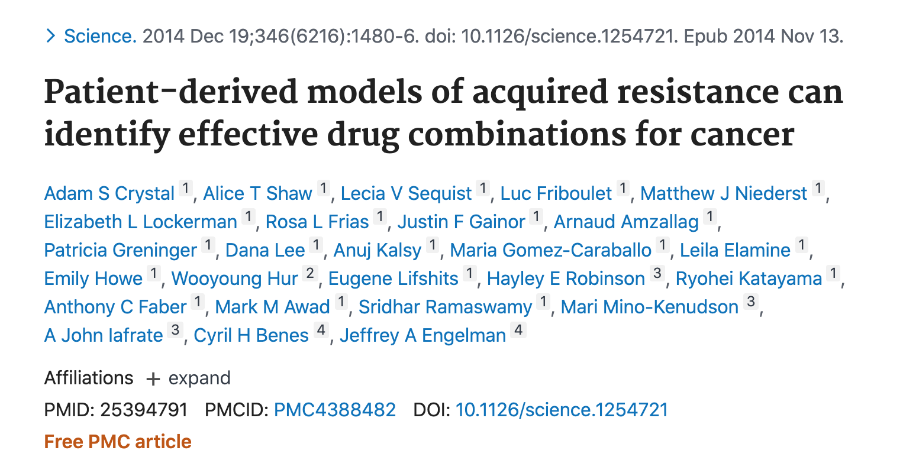
Using PDCs for predictive medicine
Conclusions:
PDCs demonstrate that lung cancer chemoresistance correlates with predictions from gene sequencing
PDCs identify chemoresistance activity of previously undescribed mutations
PDCs identify new mechanisms of chemoresistance in which there are no mutations
in the corresponding genes (e.g. src)

Slide 7
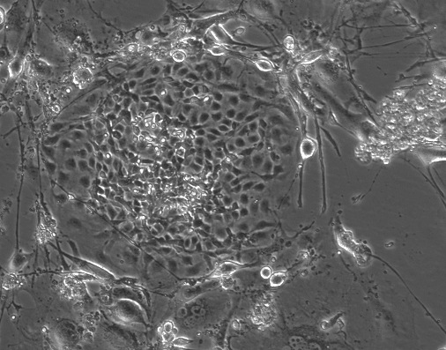
PDCs from solid tumors: Pancreatic Adenocarcinoma
Pancreatic adenocarcinoma
CRC
#Cultures
AA #12
GUMC-428
1
G/G
GUMC-108
1
G/D
GUMC-446
1
G/D
GUMC-360
1
G/D
3 out of 4 pancreatic adenocarcinoma CRCs
harbored mutant K-ras at AA #12
PT
CRC
CR cells maintain similar profile of gene
expression as primary tumor, except
for gene expression of stromal cells.
Xuefeng Liu/Seema Agarwal/David Rimm

Slide 8
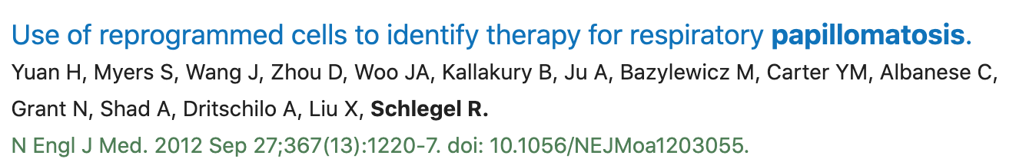
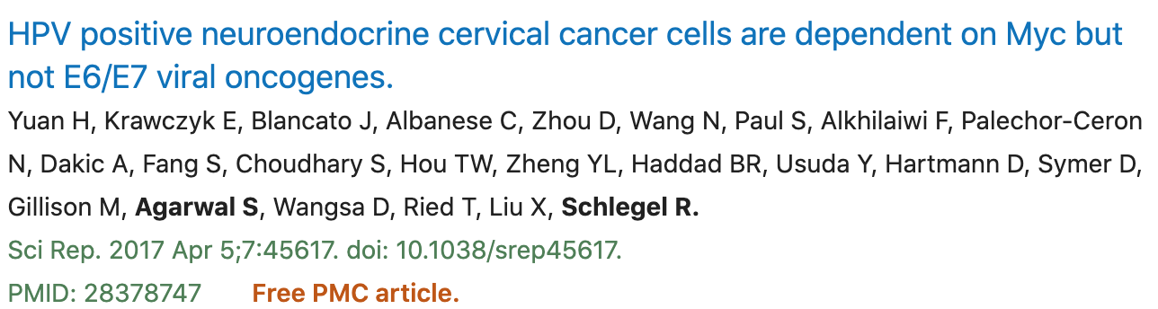
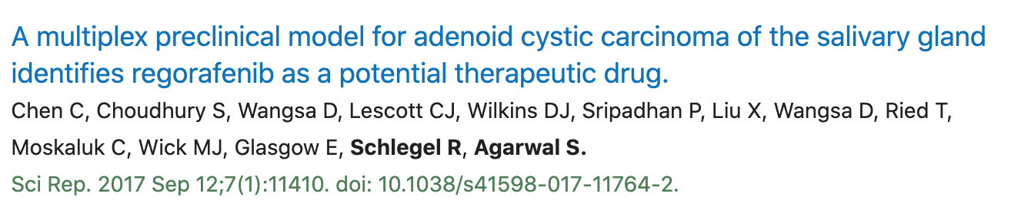
PDCs can be generated from rare human tumors

Slide 9
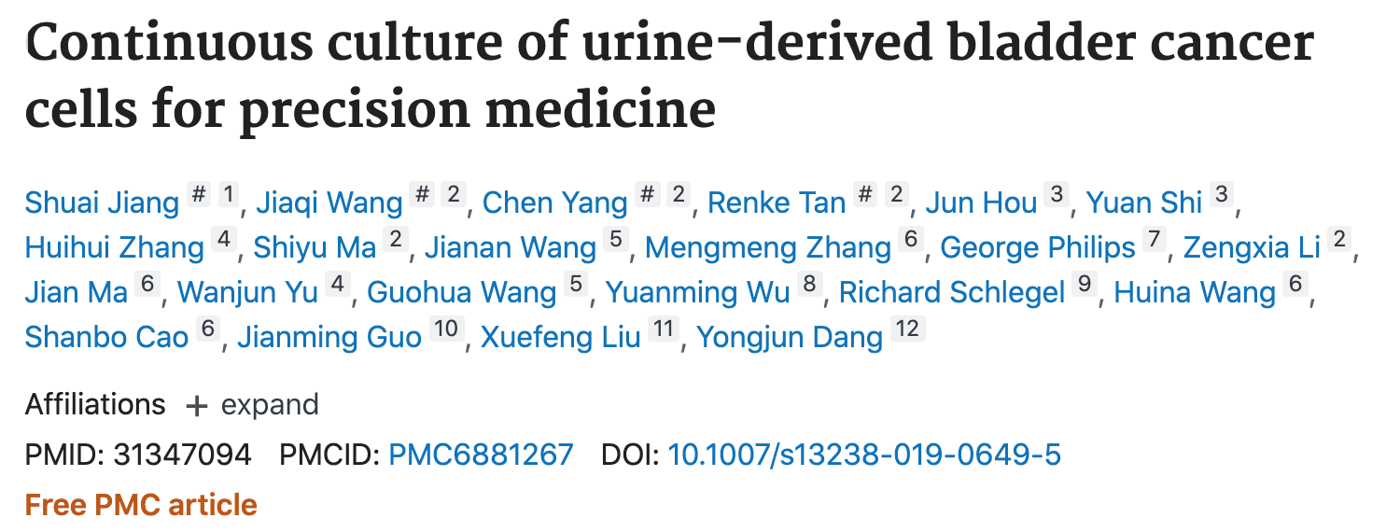
PDCs can be generated from urine and blood

Slide 10
PDCs generated from urine samples
A
Urine CRC
B
Urine CRC
Success Rate（%）
C

Slide 11
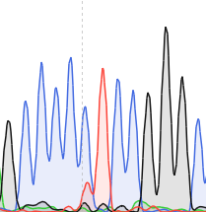
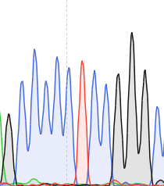
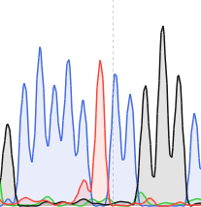
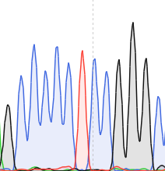
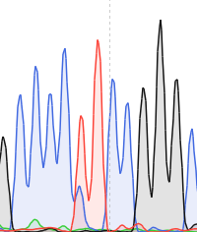
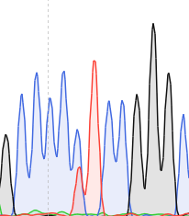
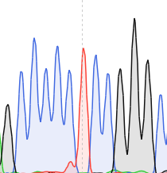
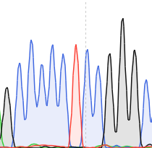
Mutations in the hTERT promoter of urine PDCs
C124T
C124
C124T
C124
Patient 4
Urine
PDC
Tumor PDC
Tumor Tissue
Blood
C124T
C124T
C124T
C124
Patient 5
Urine PDC
Tumor PDC
Tumor Tissue
Blood

Slide 12
Probing the viable subpopulation of CTCs
Probing the viable subpopulation of CTCs:
Non-viable CTCs may not reflect genotype or phenotype of
appropriate target cells
2. vCTCs offer the potential for selecting alternative or
combination therapies during disease progression
3. vCTCs provide unlimited supply of cells for analysis
4. Currently vCTCs are designed for characterization
rather than detection

Slide 13
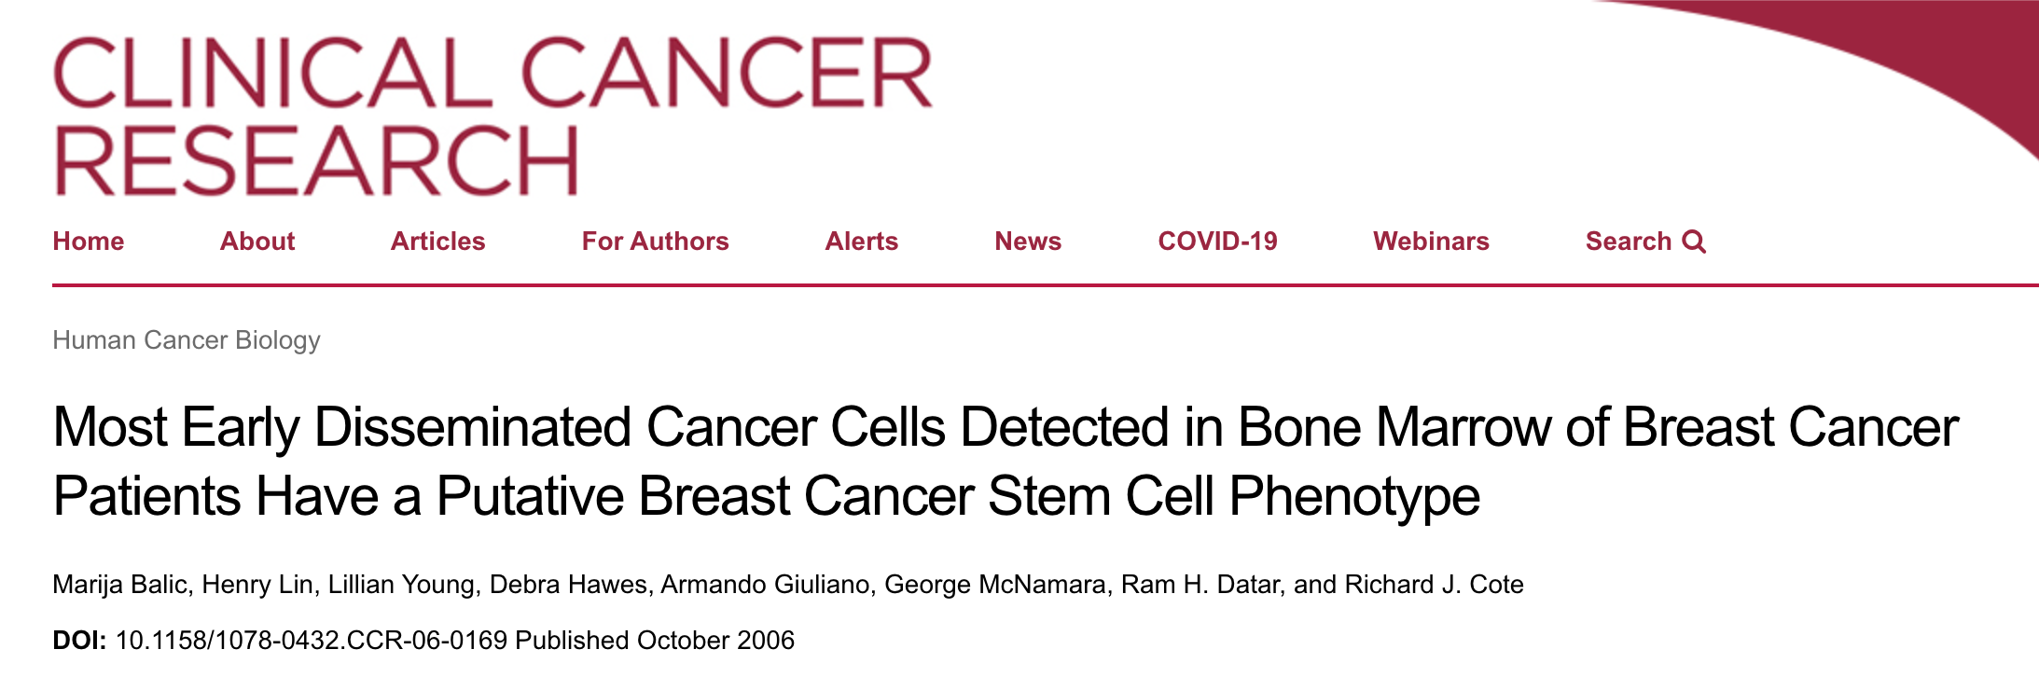
Improved method for generating CTC PDCs

