Slide 1
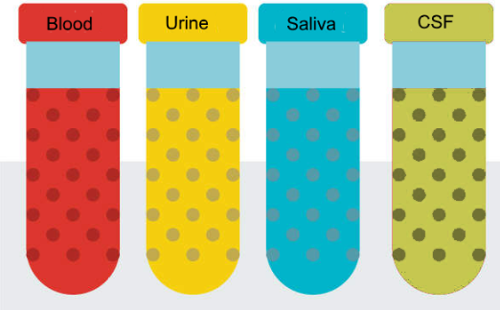
National Cancer Institute Symposium on Charting the Course of Liquid Biopsy in Precision Prevention and Treatment
December 15-16, 2021
Johns Hopkins
MGH
MGH
Washington U
UCLA
Yale

Slide 2
Earlier Detection of Cancer in Average and High-risk individuals
Earlier Detection of Cancer Using Non-Plasma Based Liquid Biopsies
Nick Papadopoulos and Chetan Bettegowda
Johns Hopkins School of Medicine
Development of highly specific and cost-effective tests for the detection of cancer
Validation of the methods in prospective trials

Slide 3
Multi-Analyte Tests
Genetic
Epigenetic
combination
algorithm
Physical qualities
Increased levels
of proteins

Slide 4
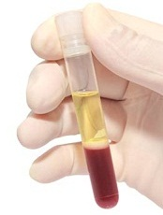
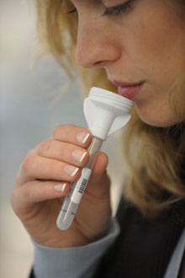
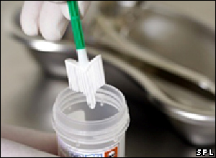
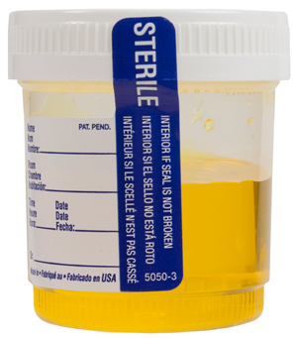
Methods adaptable to multiple applications
Multi-Analyte
Tests

Slide 5
Thank You!
Johns Hopkins
MGH
MGH
Washington U
UCLA
Yale

