Slide 1
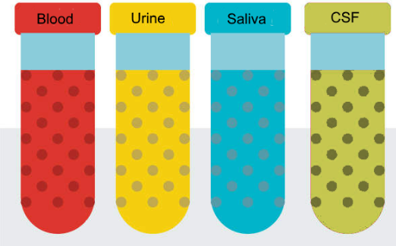
National Cancer Institute Symposium on Charting the Course of Liquid Biopsy in Precision Prevention and Treatment
December 15-16, 2021
Johns Hopkins
MGH
MGH
Washington U
UCLA
Yale

Slide 2
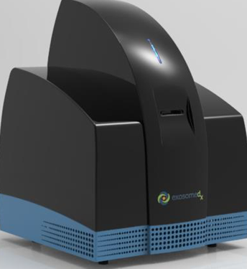
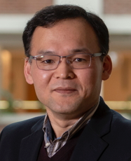
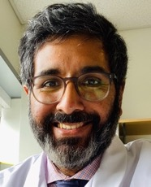
OCEAN Project
Ovarian Cancer Exosomal Analysis with Nanoplasmonics
Hakho Lee, PhD
Cesar M. Castro, MD
Johan Skog, PhD
Daniela Dinulescu, PhD
Lee
Castro
Skog
Dinulescu
Notes:
Addresses the technical challenges in extracellular vesicle (EV) analyses, rigorously evaluate EVs’ clinical value for early detection of ovarian cancer through the OCEAN system (Ovarian Cancer Exosomal Analysis with Nanoplasmonics), and establish standard methodology for total EV isolation and enrichment
Screen EVs from novel genetically engineered mouse models that closely mimic human ovarian cancer pathology

Slide 3
Our goal is to establish EV-based liquid biopsy for early detection of ovarian cancer.

Slide 4
Our goal is to establish EV-based liquid biopsy for early detection of ovarian cancer. (continued)

Slide 5
Thank You!
Johns Hopkins
MGH
MGH
Washington U
UCLA
Yale

